Slide 1
Dr. A. Chuku Miss. M. Owoseni Mr. G. Akomolafe
GENERAL BIOLOGY 11 BLY121

Slide 2
TOPIC
PROKARYOTES
FUNGI
LOWER PLANTS (CRYPTOGAMS)
ALGAE

Slide 3
PROKARYOTES
Prokaryotes are single-celled organisms.
They are the smallest, simplest organisms.
They are the earliest and most primitive forms of life on earth.
They are a group of organisms whose cells lack a cell nucleus
They are abundant in the air, water, soil, and on most objects

Slide 4
PROKARYOTES
The word prokaryote comes from the Greek word (pro) "before"+ (karyon) “nut or kernel".
Prokaryotes do not have a nucleus, mitochondria or any other membrane-bound organelles.
This means that all their intracellular water-soluble components (proteins, DNA and metabolites) are located together in the same area enclosed by cell membrane rather than separated in different cellular compartments

Slide 5
Prokaryotes have two major classification domains
Bacteria
Archaea
Prokaryotic cells have various shapes; the four basic shapes are
Cocci – spherical
Bacilli– rod-shaped
Spirochaete – spiral-shaped
Vibrio– comma-shaped

Slide 6
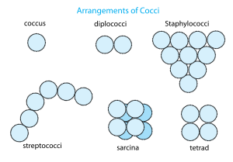
Cocci – spherical Staphylococcus aureus

Slide 7
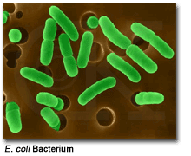
Bacilli – rod-shaped

Slide 8
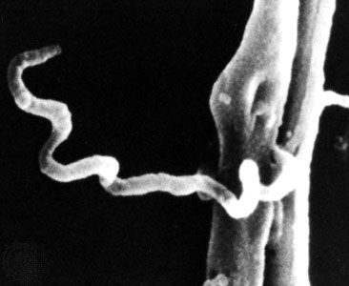
Spirochaete – spiral-shaped Treponema pallidum

Slide 9
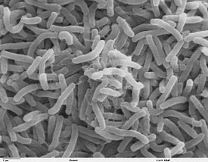
Vibrio – comma-shaped Vibrio cholera bacteria

Slide 10
Environment
Prokaryotes live in nearly all environments on Earth.
Some archaea and bacteria thrive in harsh conditions, such as high temperatures (thermophiles) or high salinity (halophiles). Organisms such as these are referred to as extremophiles.
Many archaea grow as plankton in the oceans.
Symbiotic prokaryotes live in or on the bodies of other organisms, including humans. .
Prokaryotes are able to live and thrive in various types of environments including extreme habitats such as hydrothermal vents, hot springs, swamps, wetlands, and the guts of animals

Slide 11
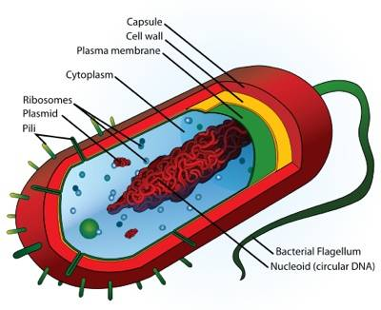
Prokaryotic Cell Structure

Slide 12
Prokaryotic cells are not as complex as eukaryotic cells.
They have no true nucleus as the DNA is not contained within a membrane or separated from the rest of the cell, but is coiled up in a region of the cytoplasm called the nucleoid.
Using bacteria as our sample prokaryote, the following structures can be found in bacterial cells

Slide 13
Capsule - Found in some bacterial cells, this additional outer covering protects the cell when it is engulfed by other organisms, assists in retaining moisture, and helps the cell adhere to surfaces and nutrients
Cell Wall - Outer covering of most cells that protects the bacterial cell and gives it shape
Cytoplasm - A gel-like substance composed mainly of water that also contains enzymes, salts, cell components, and various organic molecules

Slide 14
Cell Membrane or Plasma Membrane - Surrounds the cell's cytoplasm and regulates the flow of substances in and out of the cell
Pili - Hair-like structures on the surface of the cell that attach to other bacterial cells. Shorter pili called fimbriae help bacteria attach to surfaces.
Flagella - Long, whip-like protrusion that aids in cellular locomotion
Ribosomes - Cell structures responsible for protein production.

Slide 15
Plasmids - Gene carrying, circular DNA structures that are not involved in reproduction
Nucleiod Region - Area of the cytoplasm that contains the single bacterial DNA molecule

Slide 16
Importance of Bacteria
Bacteria perform many important functions on earth.
They serve as decomposers, agents of fermentation, and play an important role in our own digestive system.
Also, bacteria are involved in many nutrient cycles such as the nitrogen cycle, which restores nitrate into the soil for plants.
Unlike eukaryotic cells that depend on oxygen for their metabolism, prokaryotic cells enjoy a diverse array of metabolic functions. For example, some bacteria use sulfur instead of oxygen in their metabolism.

Slide 17
FUNGI
Fungi are eucaryotic, spore bearing protists that lack chlorophyll.
They generally reproduce sexually and asexually
They comprise ;
Moulds-which are filamentous and multicellular
Yeast- which are unicellular.

Slide 18
Characteristics of Fungi
They are typically filamentous
They exhibit apical growth i.e. grow only at the tips
They are heterotrophs (no chlorophyll)
They reproduce by means of spore usually wind disseminated
Both sexual (meiotic) and asexual (mitotic) spores may be produced depending on the species and condition
They are typically non motile but a few have a motile phase (chytrids)

Slide 19
Structure of Fungi
Multicellular fungi are composed of filaments called hyphae (singular: hypha).
Hyphae may contain internal crosswalls, called septa, that divide the hyphae into separate cells.
The hyphae may be branched. A mass of hyphae that is not a reproductive structure is called a mycelium.
The cell walls of fungi are composed of chitin, which is what arthropod (insects, crayfish, etc.) exoskeletons are composed of.

Slide 20
Nutrition
Fungi are heterotrophs. They cannot manufacture their own food as photosynthetic organisms can.
Most species of fungi are saprotrophic; they decompose dead matter. Many are parasitic; they obtain nutrients from living organisms.
Fungi are the principle decomposers in every ecosystem. They can break down most organic compounds including lignin, a compound that is a major component of wood and is very difficult to break down or digest.

Slide 21
Nutrition
Some species are parasites and others are mutualistic
They have extracellular digestion by secreting enzymes into environment and absorbing the nutrients produced
Fungi store their food as glycogen (like animals). Plants and green algae store their food as starch

Slide 22
Classification of Fungi
The classification of fungi is based primarily on;
The sexual spores
Fruiting bodies
Fungi can be divided into two groups
The wall-less fungi- Myxomycota
The true walled fungi- Eumycota

Slide 23
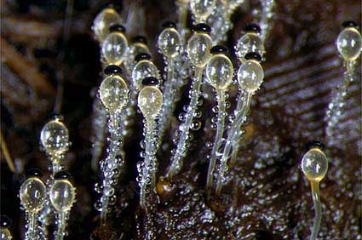
True walled fungi
They are further subdivided into four main groups;
Zygomycotina e.g Rhizopus, Mucor

Slide 24
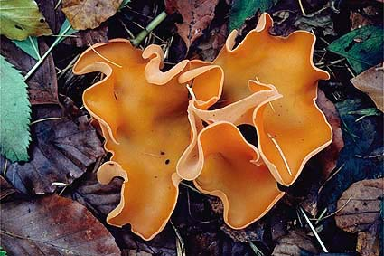
Ascomycotina e.g Saccharomyces cervisiae

Slide 25
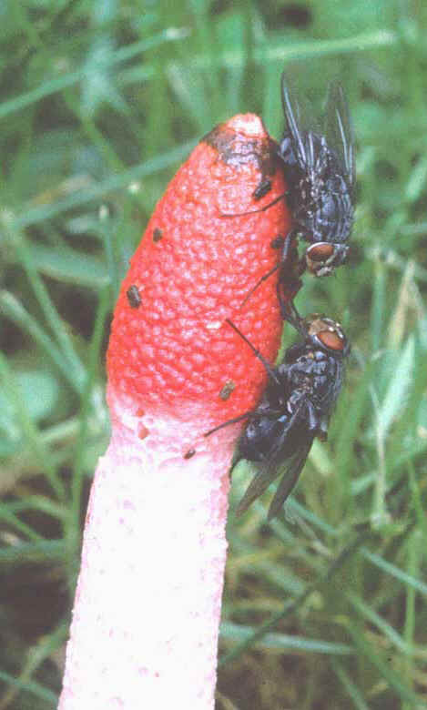
Basidiomycotina e.g mushrooms and puffballs

Slide 26
True-walled fungi cont’d
Deuteromycotina e.g Alternaria, Aspergillus, Penicillium

Slide 27
Reproduction
Most fungi are capable of asexual and sexual reproduction.
Asexual reproduction is by fragmentation or spore formation.
Those that reproduce sexually produce gametes in specialized areas of the hyphae called gametangia
In general, the life cycle involves the fusion of hyphae from two individuals, forming a mycelium that contains haploid nuclei of both individuals.

Slide 28
Reproduction cont’d
The fusion of hyphae is called plasmogamy.
The fused hyphae containing haploid nuclei from two individuals is heterokaryotic.
Eventually, two nuclei that originated from different individuals fuse to form a diploid zygote. Meiosis then produces either four haploid nuclei or four haploid cells.

Slide 29
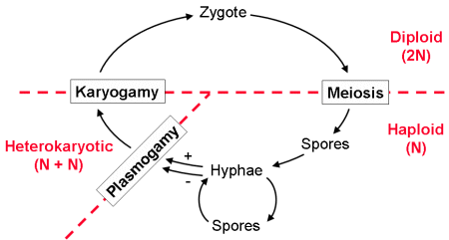

Slide 30
The Importance of Fungi
Recycling Fungi, together with bacteria, are responsible for most of the recycling which returns dead material to the soil in a form in which it can be reused.
Mycorrhizae and plant growth Fungi are vitally important for the good growth of most plants, including crops, through the development of mycorrhizal associations

Slide 31
Imp. Of Fungi cont’d
Food Fungi are also important directly as food for humans. Many mushrooms are edible and different species are cultivated for sale. These include cheeses, beer and wine, bread, some cakes, and some soya bean products
Medicines Penicillin, perhaps the most famous of all antibiotic drugs, is derived from a common fungus called Penicillium

Slide 32
Imp. Of Fungi cont’d
Biocontrol Fungi such as the Chinese caterpillar fungus, which parasitises insects, can be extremely useful for controlling insect pests of crops.
Crop Diseases Some fungi are parasites of plants. Most of our common crop plants are susceptible to fungal attack of one kind or another. Fungal diseases can on occasion result in the loss of entire crops if they are not treated with antifungal agents.

Slide 33
Imp. Of Fungi con’td
Animal Disease Fungi can also parasitise domestic animals causing diseases. Athletes foot and Candida infections are examples of human fungal infections.
Food Spoilage
Fungal damage can be responsible for large losses of stored food

Slide 34
LOWER PLANTS (CRYPTOGAMS)
Lower plants are also known as Cryptogams because their reproductive organs are hidden and non-conspicuous like flowers in higher plants
They are made up of three Phyla;
Thallophyta (Algae),
Bryophyta (Mosses, liverworts and hornworts)
Pteridophyta (Ferns and Fern allies)

Slide 35
General Characteristics
They evolved earlier than higher plants
They are seedless plants
They possess simple reproductive structures

Slide 36
BRYOPHYTES
The word Bryophyta is derived from two Greek words: Bryon meaning ‘moss’ and phyta meaning ‘plant’. They are commonly referred to as amphibians of the plant kingdom. Members include
liverworts,
Hornworts
mosses.
They are higher than the Thallophytes but lower than Pteridophytes.

Slide 37
Characteristics of Bryophytes
They are small plants lacking true roots, stems and leaves
They lack vascular tissues (xylem and phloem)
They lack cuticle on their body surfaces
They require water for reproduction, therefore are mostly found in moist habitats
They are widely distributed i.e. found in almost all habitats

Slide 38
Characteristics of Bryophytes cont’d
Their sex organs are multicellular and include the male organ; antheridium (plural: antheridia) and female organ; archegonium (plural: archegonia)
They produce spores in structures called capsules
They undergo changing of life cycle between gametophytic (n)and sporophytic (2n) generations called alternation of generation where the gametophyte is the dominant form.

Slide 39
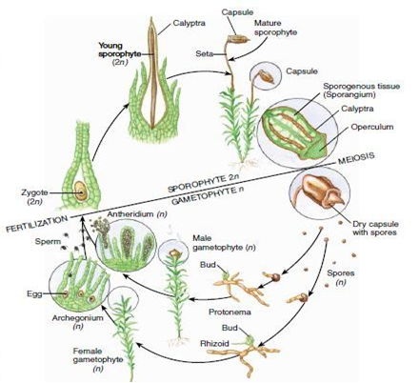
Reproduction in Bryophytes

Slide 40
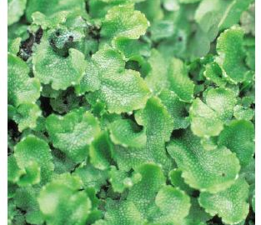
General Classification of Bryophytes
Bryophytes are classified generally into three classes
Class 1: Hepaticae or liverworts e.g. Riccia and Marchantia (thalloid liverworts), Pellia and Porella (leafy liverworts)

Slide 41
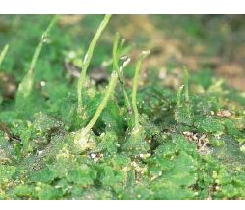
Class 2: Anthoceratae or horned liverworts which have about 300 species. They are the smallest group of bryophytes. Example includes Anthoceros

Slide 42
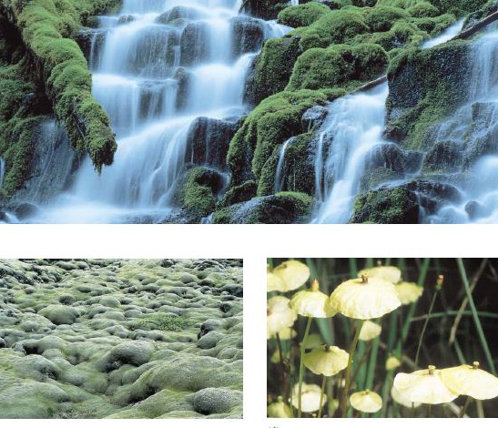
Class 3: Musci or Mosses E.g. Sphagnum, Funaria, Polytrichum, Barbula, Dicranella e.t.c. These are the largest and most familiar group of bryophytes.

Slide 43
DIFFERENCES BETWEEN LIVERWORTS AND MOSSES
Liverworts | Mosses
Gametophytes are either leafy or thalloid | Gametophytes are all leafy
Leaves are usually lobed | Leaves are non-lobed
Leaves have no midrib | Leaves usually have thickened midrib
The life span of the sporophytes is relatively short | Life span of sporophytes is relatively long
Stomata are absent in the sporophyte | Stomata are present in the sporophyte
Leaves are only one cell layered | They are multi-layered
Columella is absent in the capsule | Columella is present in the center of the capsule
Peristome teeth are absent | Peristome teeth are present on the rim of the capsule

Slide 44
PTERIDOPHYTA
Pteridophytes have been described as vascular cryptogams and lower vascular plants.
They are lower plants because they share some characteristics with thallophyta and bryophyte.
They are vascular plants because like the higher plants, they posses xylem and phloem. Therefore they occupy the intermediate position between bryophyta and spermatophyte. Pteridophytes are commonly known as ferns and fern allies

Slide 45
General characteristics
Pteridophytes constitutes a large group of lower plants with the members having diverse features
They also exhibit alternation of generation where the sporophyte is the dominant form
The sporophyte can be differentiated into true root, true stem and true leaves like in the higher plants
They posses well developed vascular tissues i.e. xylem and phloem

Slide 46
General characteristics
The epidermis of the sporophytes are covered by cuticle and are also equipped with stomata
The sporophyte may produce the same kind of spores (homosporous) or two different kinds of spores (heterosporous) as in higher plants.
Leaves are formed from the uncurling of the crozier or fiddlehead

Slide 47
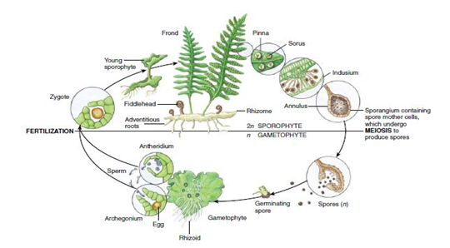
Reproduction in Pteridophytes

Slide 48
General Classification of Pteridophytes
There are four main sub-divisions namely:
Psilotopsida
Lycopsida
Sphenosida
Pteropsida

Slide 49
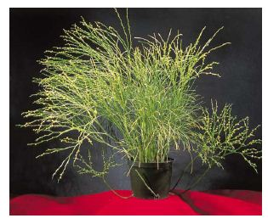
Psilotopsida
commonly known as Psilotophytes
They have poorly developed plant body and absence of true roots but produces rhizoids
Their spores are homospores.

Slide 50
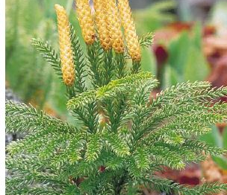
Lycopsida:
They are called club mosses.
Their leaves are small and simple. Each is known as a microphyl.
Their sporangia may be homosporous or heterosporous.
Examples include Lycopodium and Selaginella

Slide 51
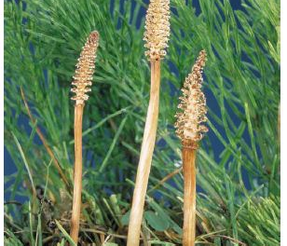
Sphenopsida
They are known as horsetails.
The sporangia are borne on special structures called strobili or cones.
Most of them are homosporous. The leaves are small (scale-like) and in whorls at the nodes of the stem which is aerial or its branches.

Slide 52
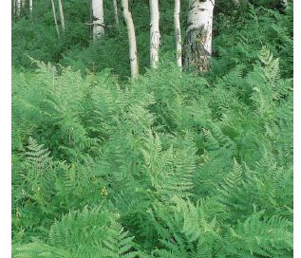
Pteropsida
These are commonly called ferns.
They posses large leaves called megaphylls.
The ferns produced numerous adventitious roots called rhizome.
Ferns exhibit circinate venation which is the rolling up of the young fern blade or crozier.
They are either homosporous or heterosporous.
Their sporangia are found in groups called sori
. Examples include Dryopteris, Nephrolepis, Pteridium, Platycerium

Slide 53
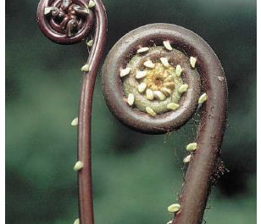
The fiddlehead of a fern

Slide 54
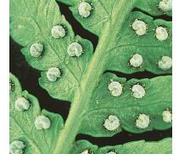
The arrangement of sori underneath the surface of the leaflets

Slide 55
THALLOPHYTA-ALGAE
The algae are a group of lower plants belonging to the large group of simple plants called thallophytes. E.g
Chlorella and Chlamydomonas
Spirogyra
Pithophora
Euglena
Fucus
Volvox
Nostoc and Anabaena
Red Algae- Porphyra, Polysiphonia

Slide 56
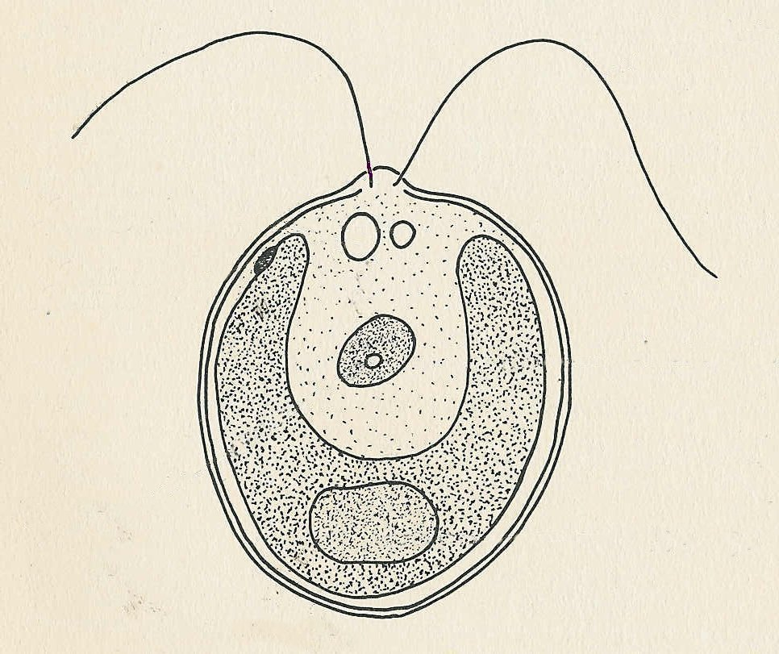
Groups of Algae
Green Algae- Chlamydomonas,

Slide 57
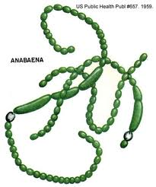
Blue-green Algae- Nostoc, Anabaena

Slide 58
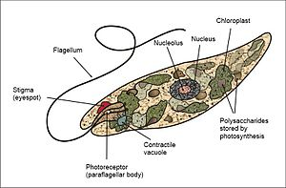
Euglena

Slide 59
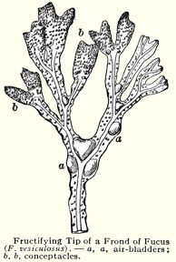
Groups of Algae cont’d
Brown Algae- Fucus

Slide 60
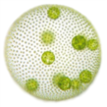
A Coenobium of Volvox

Slide 61
Characteristics of Algae
They are generally small plants. Some are unicellular while others are multi cellular. A few have complex body structure.
They possess the green pigment called chlorophyll which make them photosynthetic
They are widely distributed in nature. They are found in both marine and fresh water habitats, on land, some are epiphytic (i.e. growing on trunks and branches of other plants), while a few occur in association with other plants as lichens and in animals as in the green hydra.

Slide 62
Classification of Algae
They have simple body structure, absence of true roots, stems and leaves, absence of vascular tissues such as xylem and phloem, simple unicellular reproductive structures in the form of sporangia and sex organs and occurrence of fusion of reproductive structures outside the body of the parent plants.

Slide 63
Classification of Algae
Algae are grouped into ten general divisions which are based on four main criteria ;
The nature of their photosynthetic pigments
The nature of their cell wall components
Presence or absence of flagella and types of flagella when present
Certain details of the cell structure in the algae

Slide 64
The ten divisions of Algae
Division | Common Names | Common examples
Cyanophyta | Blue-green algae | Anabaena, Nostoc
Chlorophyta | Green algae | Chlamydomonas, Spirogyra
Xanthophtya | Yellow green algae
Chrysophyta | Golden algae | Helothrix, Nav icula
Bacillariophyta | Diatoms
Pyrrophta | Fire algae
Cryotophyta |  | Cryptomonas, Tetragonidium
Euglenophyta | Euglenoids | Euglena
Phaeophyta | Brown algae | Fucus, laminaria
Phodophyta | Red algae | Porphyra

Slide 65
Economic importance of Algae
Beneficial roles of algae
Primary producers
Human food
Fodder
Fish food
In Industries
Medicinal value
Sewage treatment
Nitrogen fixation
Miscellaneous roles
Other uses

Slide 66
Non-beneficial roles of Algae
Interference with fishing and swimming
Death of fishes E.g. Microcystis
Death of livestock species e.g. Anabaena
Death to Humans e.g. Gonyaulax
Damage to buildings e.g. Tolyppthrix
Water pollution e.g. Chlamydomonas.

